Slide 1
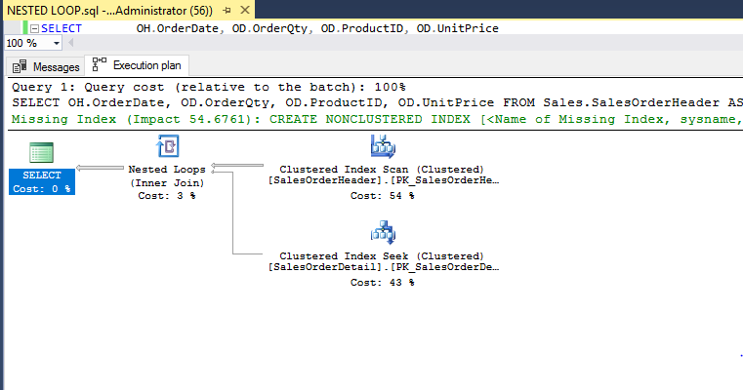
Example of joins in execution plan
What is a nested loop join? Hash Join? Merge join?
The operator on the top right is called the outer input
The just below it is called the inner input.

